Slide 1

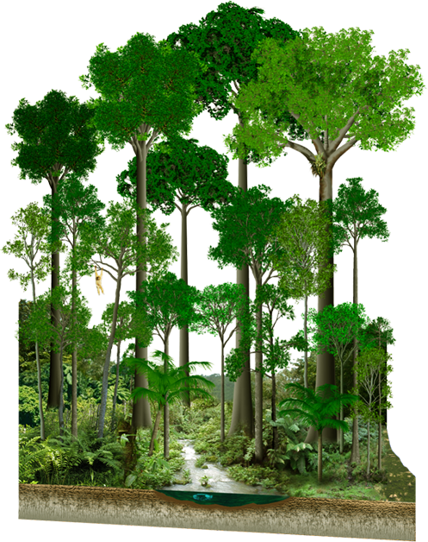

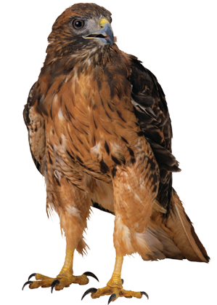
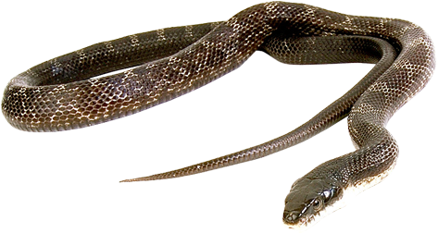

Ecology Series: Set 5
Copyright © 2005
Version: 1.0

Slide 2
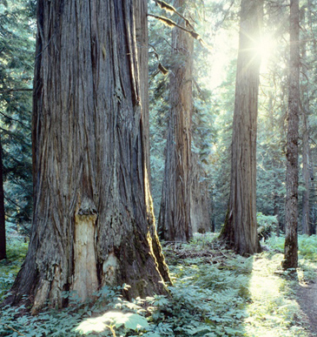
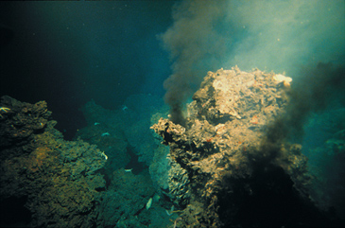
Trophic Structure 1
Every ecosystem has a trophic structure: a hierarchy of feeding relationships which determines the pathways for energy flow and nutrient cycling.
Species are assigned to trophic levels on the basis of their nutrition.
Producers (P) occupy the first trophic level and directly or indirectly support all other levels. Producers derive their energy from the sun in most cases.
  Hydrothermal vent communities are an exception; the producers are chemosynthetic bacteria that derive energy by oxidizing hydrogen sulfide.
Deep sea hydrothermal vent

Slide 3

Trophic Structure 2
Producer
(P)
All organisms other than producers are consumers (C).
Consumers are ranked according to the trophic level they occupy. First order (or primary) consumers (herbivores), rely directly on producers for their energy.
  A special class of consumers, the detritivores, derive their energy from the detritus representing all trophic levels.
Photosynthetic productivity (the amount of food generated per unit time through photosynthesis) sets the limit for the energy budget of an ecosystem.
Consumer
(C1)
Consumer
(C2)
Consumer
(C3)

Slide 4
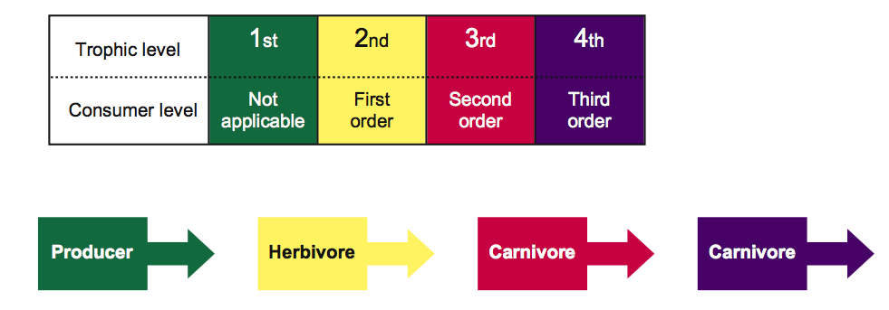
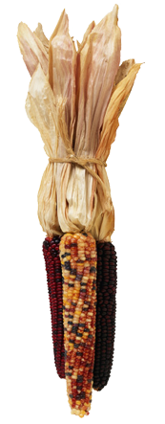
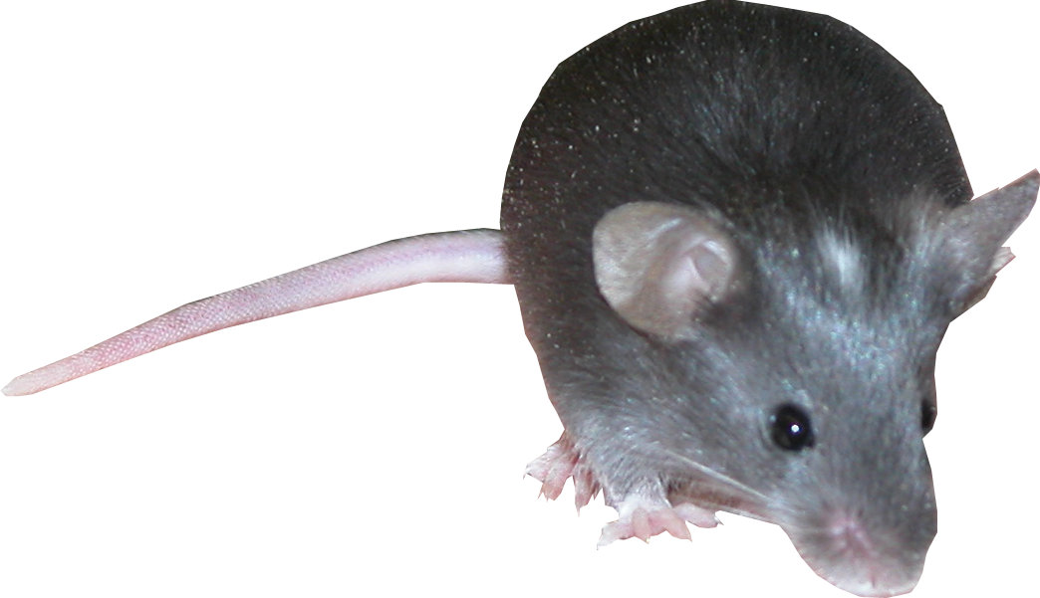
Organisation of Trophic Levels
Trophic structure can be described by trophic level or consumer level:

Slide 5
Major Trophic Levels
Trophic Level | Source of Energy | Examples
Producers | Solar energy | Green plants, photosynthetic protists and bacteria
Herbivores | Producers | Grasshoppers, water fleas, antelope, termites
Primary Carnivores | Herbivores | Wolves, spiders, some snakes, warblers
Secondary Carnivores | Primary carnivores | Killer whales, tuna, falcons
Omnivores | Several trophic levels | Humans, rats, opossums, bears, racoons, crabs
Detritivores and Decomposers | Wastes and dead bodies of other organisms | Fungi, many bacteria, earthworms, vultures

Slide 6
Food Chains
The sequence of organisms, each of which is a source of food for the next, is called a food chain.
  Food chains commonly have four links but seldom more than six.
  In food chains the arrows go from food to feeder.
Organisms whose food is obtained through the same number of links belong to the same trophic level.
Examples of food chains include:
Producer
(P)
1° carnivore
2° carnivore
Herbivore
seaweed
cat’s eye
whelk
seagull
aquatic macrophyte
freshwater crayfish
brown trout
kingfisher

Slide 7
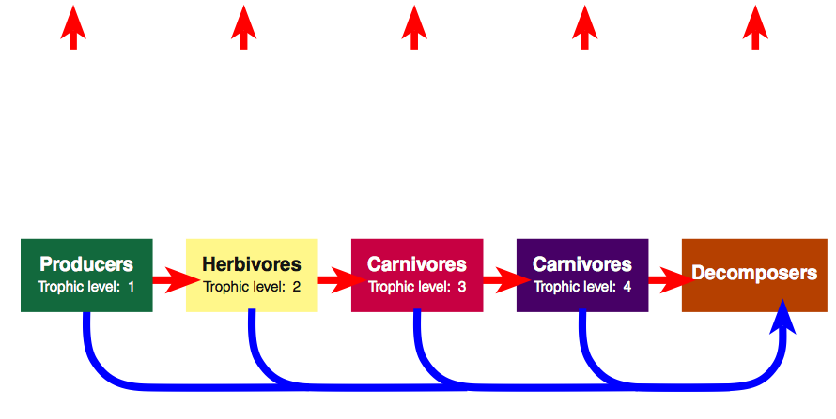
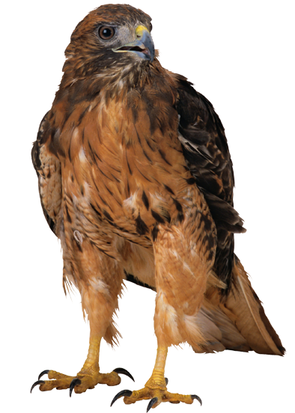
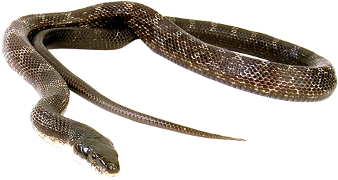
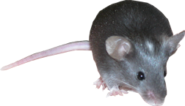
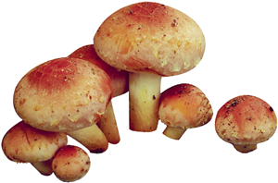
Food Chain Energy Flow
Energy is lost as heat from each trophic level via respiration.
Dead organisms at each level are decomposed.
Some secondary consumers feed directly off decomposer organisms.
Heat
Heat
Heat
Heat
Heat

Slide 8
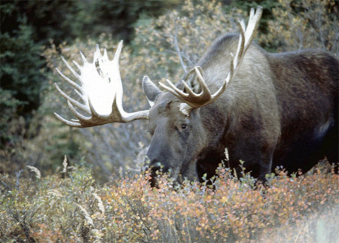
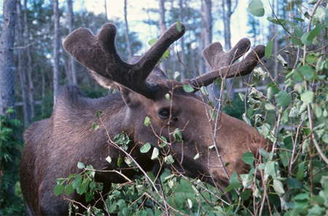
Food Webs
Some consumers (particularly ‘top’ carnivores and omnivores) may feed at several different trophic levels, and many herbivores eat many plant species.
  For example, moose feed on grasses, birch, aspen, firs, and aquatic plants.
The different food chains in an ecosystem therefore tend to form complex webs of feeding interactions called a food web.

Slide 9
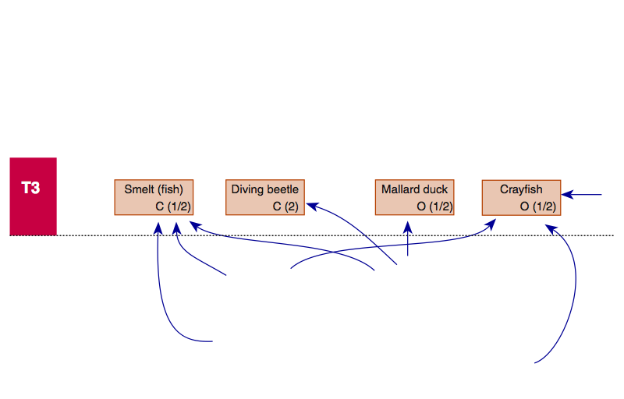
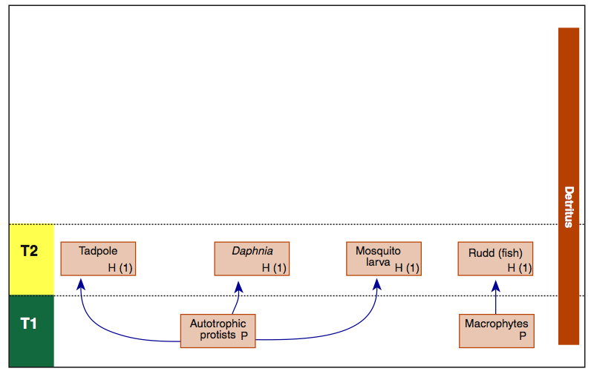
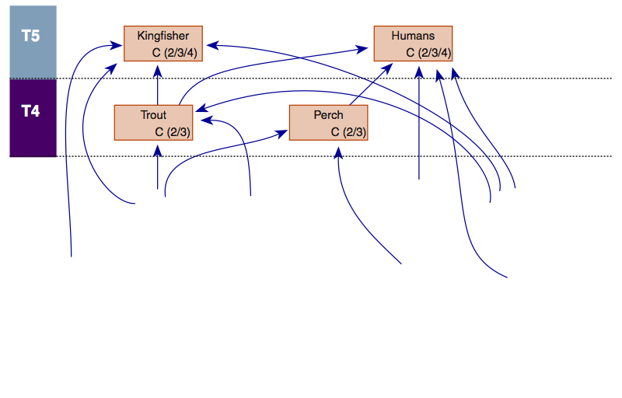
A Simple Lake Food Web
This lake food web includes only a limited number of organisms, and only two producers. Even with these restrictions, the web is complex.

Slide 10
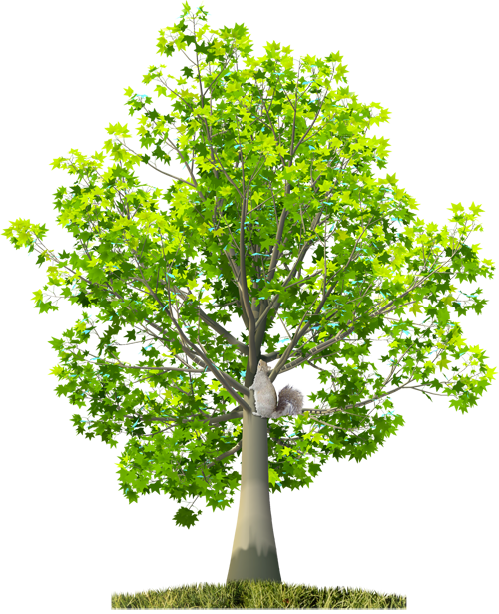
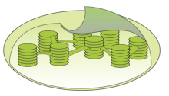


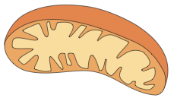
Energy in Ecosystems
Light energy
Energy, unlike, matter, cannot be recycled.
  Ecosystems must receive a constant input of new energy from an outside source which, in most cases, is the sun.
Photosynthesis
Carbon dioxide
and
water
Organic molecules and
oxygen
Cellular respiration

Slide 11
Energy in Ecosystems
Energy is ultimately lost as heat to the atmosphere.
Cellular respiration
Static biomass locks up some chemical energy
Growth and repair of tissues
Muscle contraction and flagella movement
Active transport processes, e.g. ion pumps
Production of macromolecules, e.g. proteins
Heat Energy
Cellular work and accumulated biomass ultimately dissipates as heat energy

Slide 12
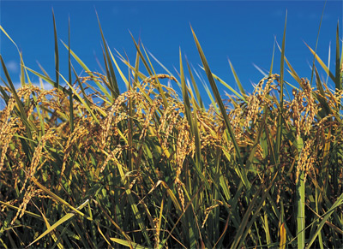
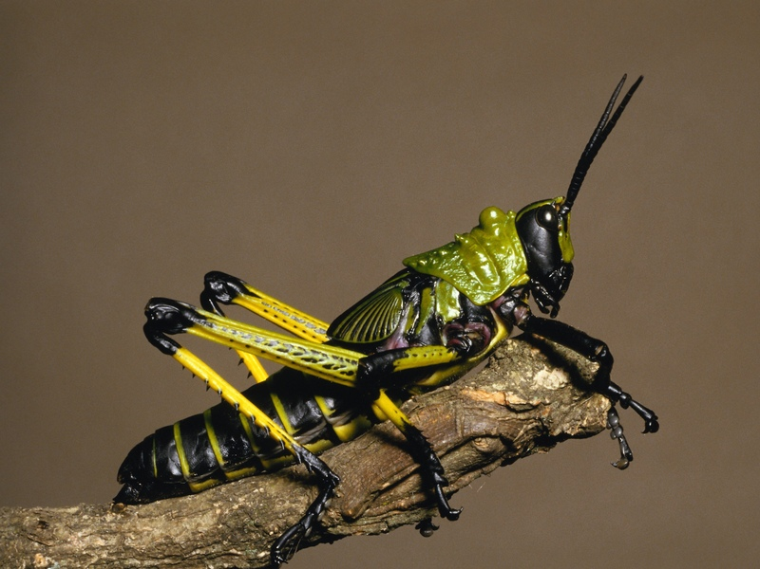
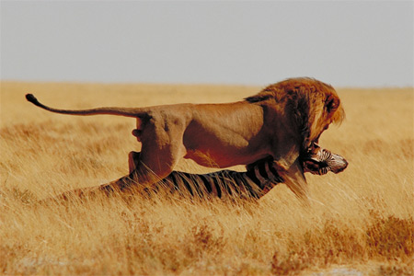
Energy Inputs and Outputs
Living things are classified according to the way in which they obtain their energy:
  Producers (or autotrophs)
  Consumers (or heterotrophs)

Slide 13
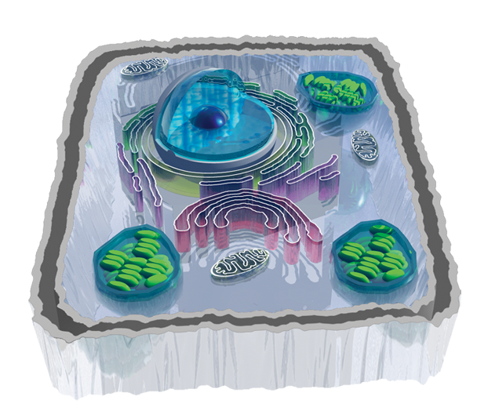
Energy Transformations
Green plants, algae, and some bacteria use the sun’s energy to produce glucose in a process called photosynthesis.
The chemical energy stored in glucose fuels metabolism.
  The photosynthesis that occurs
  in the oceans is vital to life on
  Earth, providing oxygen and
  absorbing carbon dioxide.
  Cellular respiration is the
  process by which organisms
  break down energy rich
  molecules (e.g. glucose)
  to release the energy in
  a useable form (ATP).
Cellular respiration in mitochondria
Photosynthesis in chloroplasts

Slide 14
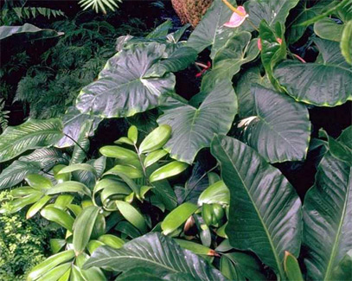
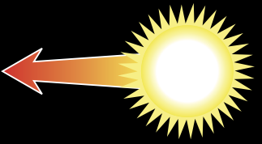
Producers
Producers are able to manufacture their food from simple inorganic substances (e.g. CO₂). Producers include green plants, algae and other photosynthetic protists, and some bacteria.
Respiration
Heat given off in the process of daily living.
Growth and new offspring
New offspring as well as new branches and leaves.
Eaten by consumers
Some tissue eaten by herbivores and omnivores.
Wastes
Metabolic waste products are released.
Producers
Solar radiation
Reflected light
Unused solar radiation is reflected off the surface of the organism.
Dead tissue
Death
Some tissue is not eaten by consumers and becomes food for decomposers.

Slide 15
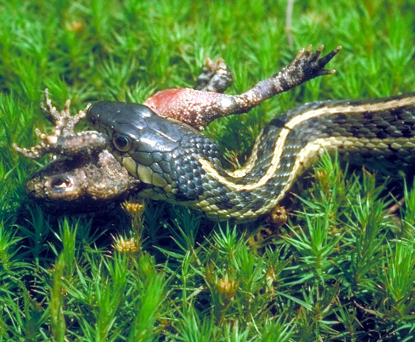
Consumers
Consumers are organisms that feed on autotrophs or on other heterotrophs to obtain their energy.
Includes: animals, heterotrophic protists, and some bacteria.
Respiration
Heat given off in the process of daily living.
Growth and reproduction
New offspring as well as growth and weight gain.
Eaten by consumers
Some tissue eaten by carnivores and omnivores.
Wastes
Metabolic waste products are released
(e.g. urine, feces, CO2)
Consumers
Food
Consumers obtain their energy from a variety of sources: plant tissues (herbivores), animal tissues (carnivores), plant and animal tissues (omnivores), dead organic matter or detritus (detritivores and decomposers).
Death
Some tissue not eaten by consumers becomes food for detritivores and decomposers.
Dead tissue

Slide 16

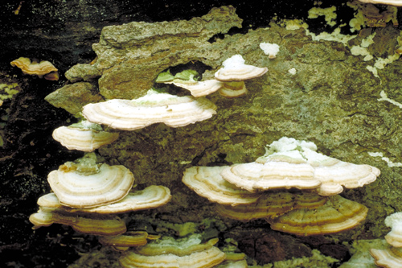
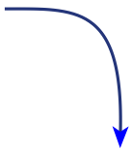
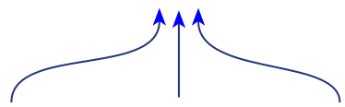
Decomposers
Decomposers are consumers that obtain their nutrients from the breakdown of dead organic matter. They include fungi and soil bacteria.
Respiration
Heat given off in the process of daily living.
Growth and reproduction
New tissue created, mostly in the form of new offspring.
Producer tissue
Nutrients released from dead tissues are absorbed by producers.
Death
Decomposers die; their tissue is broken down by other decomposers and detritivores
Wastes
Metabolic waste products are released.
Decomposers
Dead tissue
Dead tissue of producers
Dead tissue of consumers
Dead tissue of decomposers

Slide 17
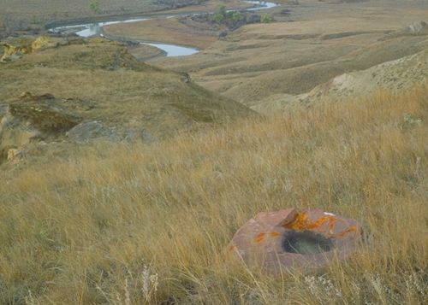
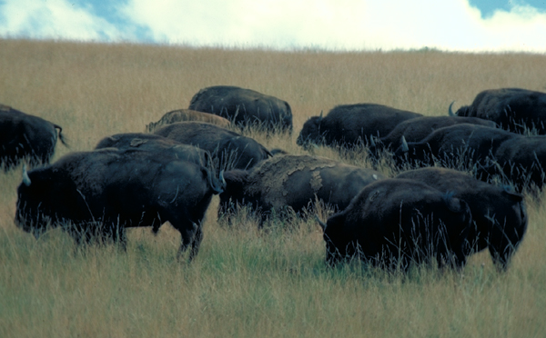
Primary Production
The energy entering ecosystems is fixed by producers in photosynthesis.
  Gross primary production (GPP) is the total energy fixed by a plant through photosynthesis.
  Net primary production (NPP) is the
  GPP minus the energy required by the plant for respiration. It represents the amount of stored chemical energy that
  will be available to consumers in an ecosystem.
  Productivity is defined as the rate of production. Net primary productivity
  is the biomass produced per unit area
  per unit time, e.g. g m⁻²y⁻¹
Grassland: high productivity
Grass biomass available to consumers

Slide 18
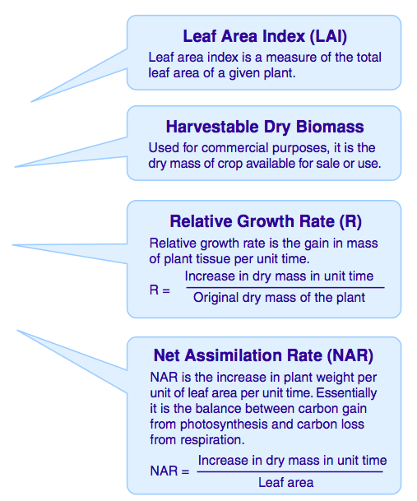
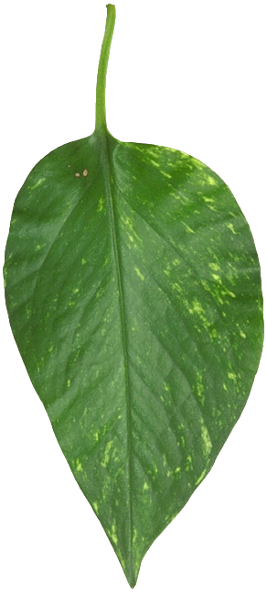
Measuring Plant Productivity
The primary productivity of an ecosystem depends on a number of interrelated
factors, such as light
intensity, temperature,
nutrient availability,
water, and
mineral supply.
The most productive ecosystems are
systems with high temperatures, plenty of water, and non-limiting supplies of soil nitrogen.

Slide 19
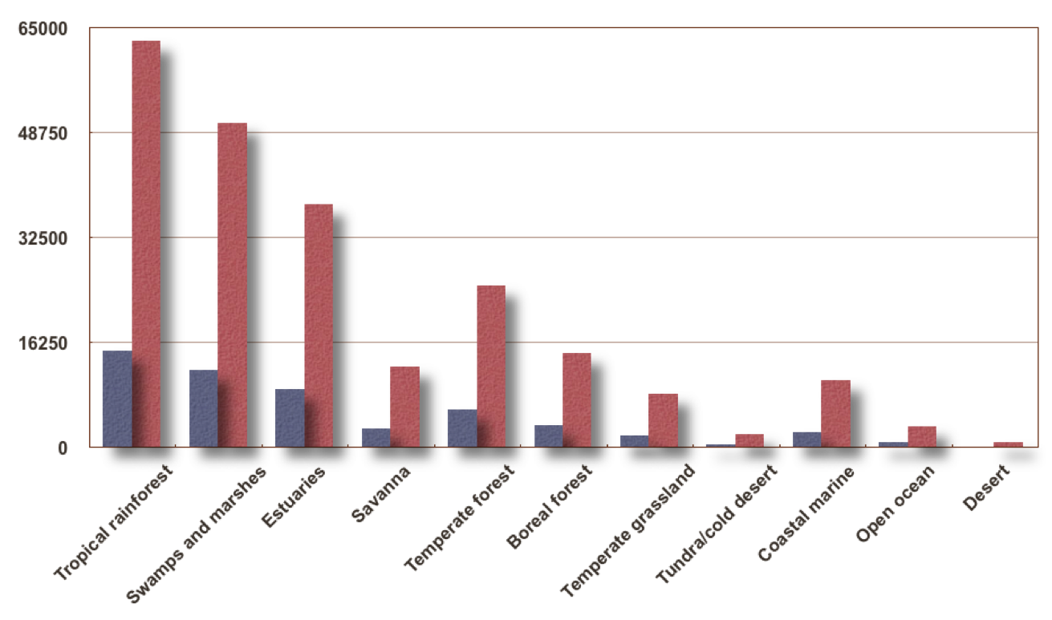

Ecosystem Productivity
The primary productivity of oceans is lower than that of terrestrial ecosystems because the water reflects (or absorbs) much of the light energy before it reaches and is utilized by the plant.
kcal m⁻²y⁻¹
Although the open ocean’s productivity is low, the ocean contributes a lot to the Earth’s total production because of its large size. Tropical rainforest also contributes a lot because of its high productivity.
kJ m⁻²y⁻¹

Slide 20
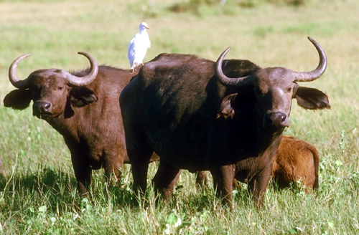
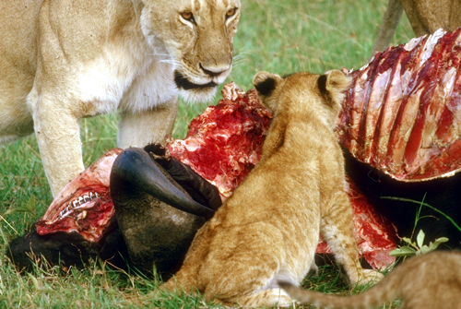
Secondary Production
Secondary production is the amount of biomass at higher trophic levels (the consumer production).
  It represents the amount of chemical energy in consumers’ food that is converted to their own new biomass.
  Energy transfers between producers and herbivores, and between herbivores and higher level consumers is inefficient.
Herbivores (1° consumers)...
Eaten by 2° consumers

Slide 21
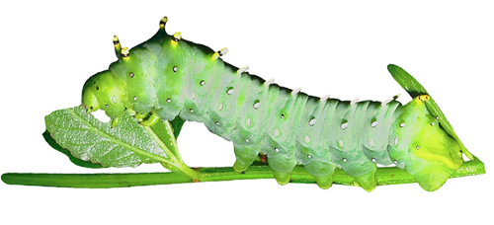

Ecological Efficiency
The percentage of energy transferred from one trophic level to the next varies between 5% and 20% and is called the ecological efficiency.
  An average figure of 10% is often used. This ten percent law states that the total energy content of a trophic level in an ecosystem is only about one-tenth that of the preceding level.
Plant material consumed by caterpillar
200 J
100 J
33 J
67 J
Feces
Growth
Cellular respiration

Slide 22
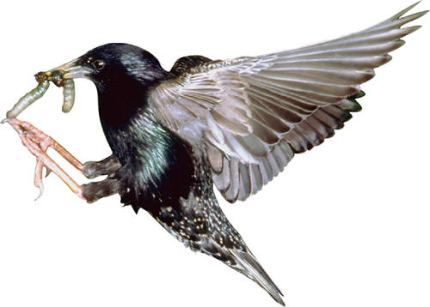
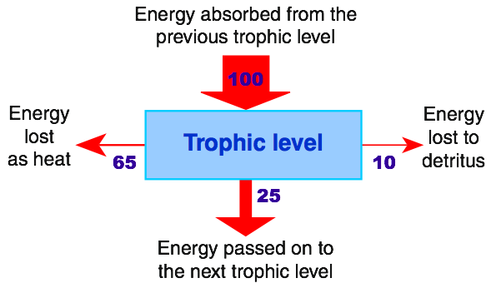
Energy Flow in Ecosystems
Energy flow into and out of each trophic level in a food chain can be represented on a diagram using arrows of different sizes to represent the different amounts of energy lost from particular levels.
The energy available to each trophic level will always equal the amount entering that trophic level, minus total losses to that level.

Slide 23
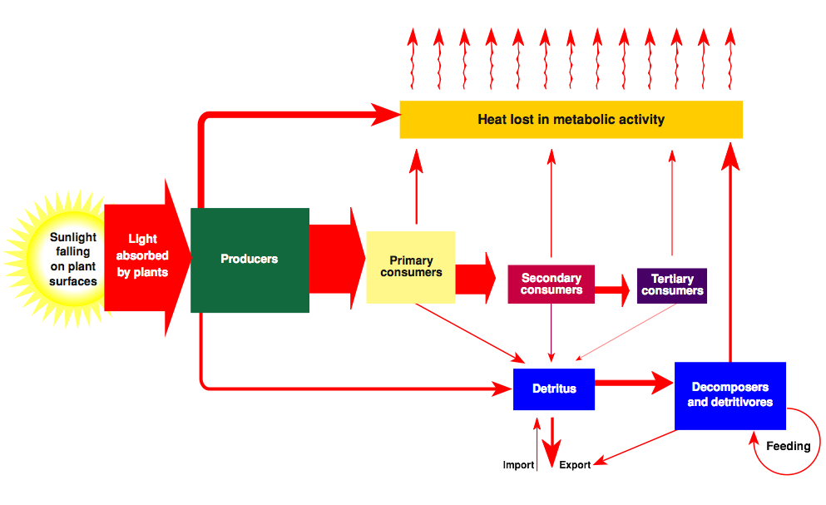
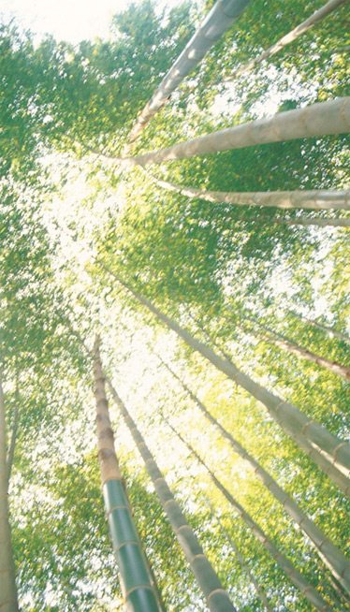
Energy Flow Diagrams
The diagram illustrates energy flow through a hypothetical ecosystem.

Slide 24
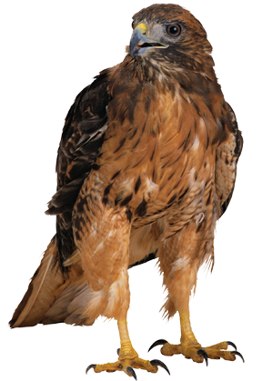
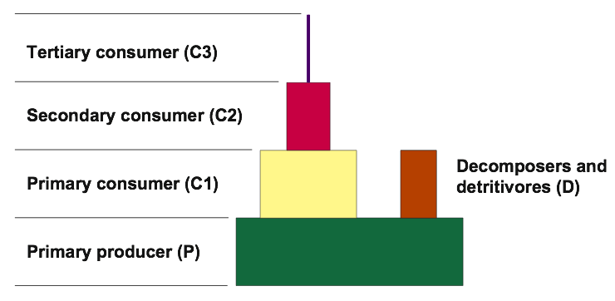
Ecological Pyramids 1
Trophic levels can be compared by determining the number, biomass, or energy content of individuals at each level.
This information can be presented as an ecological pyramid.
The base of each pyramid represents the producers and the subsequent trophic levels are added on top in their ‘feeding sequence’.

Slide 25

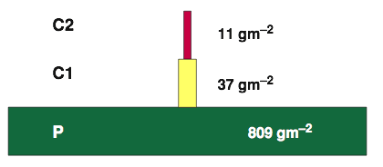
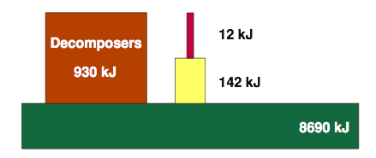
Ecological Pyramids 2
Various types of pyramid are used to describe different aspects of an ecosystem’s trophic structure:
  Pyramids of numbers: In which the size of each tier is proportional to the number of individuals present at each trophic level.
  Pyramids of biomass: Each tier represents the total dry weight of organisms at each trophic level.
  Pyramids of energy (production): The size of each tier is proportional to the production (e.g. in kJ) of each trophic level.
Pyramid of numbers
Pyramid of biomass
Pyramid of energy

Slide 26
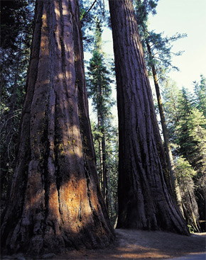
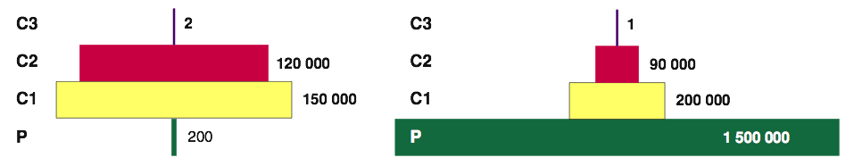
Pyramids of Numbers
In a typical pyramid of numbers, the number of individuals supported by the ecosystem at successive trophic levels declines progressively.
This reflects the fact that the smaller biomass of top level consumers tends to be concentrated in a relatively small number of large animals.
There are some exceptions. In some forests a few producers (of a very large size) may support a larger number of consumers, and the pyramid is inverted. This also occurs in plant/parasite food webs.
Forest
Grassland

Slide 27
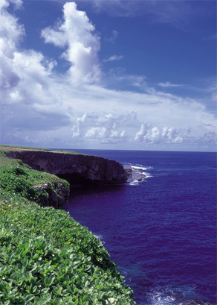


Pyramids of Biomass
In pyramids of biomass, dry weight is usually
used as the measure of mass because the water content of organisms varies.
Organism size is taken into account so meaningful comparisons of different trophic levels are possible.
Biomass pyramids may be inverted in some systems (e.g. in some plankton communities) because the algal (producer) biomass at any one time is low, but the algae are reproducing rapidly and have a high productivity.
A Florida bog community
The English Channel

Slide 28



Pyramids of Energy
Pyramids of energy (or production) are often very similar in appearance to pyramids of biomass.
The energy content at each trophic level is generally comparable to the biomass because similar amounts of dry biomass tend to have about the same energy content.
This example illustrates the similarity between pyramids of biomass (gm⁻²) and energy (kJ) in a freshwater lake community. During warm months, when algal turnover time is short, pyramids of energy and biomass may be inverted.
Zooplankton (C1)

Slide 29


Community Patterns
Communities typically show patterns in both space and time. These include:
  Zonation: Changes in the composition of a community which occur in response to an environmental gradient, e.g. with altitude or on a shoreline.
  Stratification: Layering of different plant species into distinct strata.
  Succession: Changes in the species composition of a community over time.
Altitudinal zonation
Succession on Maui, Hawaii

Slide 30


Zonation
Zonation refers to the division of an ecosystem into distinct zones that experience similar abiotic conditions.
  The gradient in the physical environment is reflected in the species assemblages found at the different zones.
  In a more global sense, differences in latitude and altitude create distinctive zones of vegetation type, or biomes.
Rock pool
The Earth from space

Slide 31


Shoreline Zonation
Zonation is particularly clear on an exposed rocky seashore, where assemblages of different species form a banding pattern approximately parallel to the waterline.
  Rocky shores exist where wave action prevents the deposition of much sediment. The rock forms a stable platform for the secure attachment of organisms such as large seaweeds and barnacles.
  Sandy shores are less stable than rocky shores and the organisms found there are adapted to the more mobile substrate.

Slide 32

Zonation on a Rocky Shore 1
Northern hemisphere: In Britain, exposed rocky shores occur along much of the western coastlines. Where several species are indicated in a zonal band, they occupy the entire band.
SHT = Extreme spring High Tide Mark
SLT = Extreme spring Low Tide Mark
MHT = Mean High Tide Mark
MLT = Mean Low Tide Mark

Slide 33

Zonation on a Sandy Shore 1
Northern hemisphere (Britain): Exposed sandy shores offer fewer opportunities for several species to coexist within the same zonal band.
SHT = Extreme spring High Tide Mark
SLT = Extreme spring Low Tide Mark
MHT = Mean High Tide Mark
MLT = Mean Low Tide Mark

Slide 34

Rocky vs Sandy Shores 1

Slide 35

Zonation on a Rocky Shore 2
Southern hemisphere: A similar pattern to the Northern hemisphere, but with Australasian species. Several species coexist within the same zone.
SHT = Extreme spring High Tide Mark
SLT = Extreme spring Low Tide Mark
MHT = Mean High Tide Mark
MLT = Mean Low Tide Mark

Slide 36

Zonation on a Sandy Shore 2
Southern hemisphere: A similar pattern to that seen in the Northern hemisphere, but with Australasian species. Note that there are fewer species occupying wider zones than on the rocky shore.
SHT = Extreme spring High Tide Mark
SLT = Extreme spring Low Tide Mark
MHT = Mean High Tide Mark
MLT = Mean Low Tide Mark

Slide 37

Rocky vs Sandy Shores 2

Slide 38

Zonation With Altitude
Altitudinal zonation is clearly visible on the sides of mountains. With increasing altitude, the vegetation changes in composition, growth form, and height.
  Zonation patterns may provide the basis for defining vegetation types in the region.

Slide 39


Community Change With Altitude
Both vegetation and soil type may change with increasing altitude.
  On Mount Kosciusko, Australia, low altitude soils have low levels of organic matter supporting dry tussock grassland vegetation.
  The high altitude alpine soils are rich in organic matter, largely due to slow decay rates.

Slide 40

Stratification
Stratification describes a pattern of vertical layering where the layers (or strata) comprise different vegetation types.
Stratification is a feature of both temperate and tropical forest communities throughout the world.
Species composition varies according to local conditions (altitude, soil type, temperature, precipitation) and vegetation history.

Slide 41
Tropical Rainforest Structure
Canopy
Tropical rainforests are complex and can be divided into four distinct strata representing zones of different vegetation.
The strata are:
  Canopy
  Subcanopy
  Understorey
  Ground layer.
In addition, epiphytes (perching plants) and lianes (climbing vines) occupy several strata in the forest.
Subcanopy
Understorey
Ground layer

Slide 42

Epiphytes and Lianes
Perching plants, or epiphytes, cling to the trunks of the canopy trees or grow in the leaf litter that accumulates between the branching limbs of large trees.
  Epiphytic species include many ferns and orchids; about half of the world’s estimated 30 000 orchid species are epiphytic.
Lianes are rooted in the ground, but clamber into the canopy where higher light levels enable them to develop extensive foliage.
Staghorn fern
Fern
Orchid
Queensland tropical rainforest

Slide 43

Podocarp Forest Structure
Emergent
Canopy
Lowland podocarp-broadleaf forests in the Southern Hemisphere have a more complex structure than the temperate (cool) forests of the Northern Hemisphere, with at least five strata as well as epiphytes, lianes, and emergents.
Subcanopy
Epiphyte
Tree fern layer
Shrub layer
Ground layer

Slide 44
Ecological Succession
Ecological succession is the process by which communities in a particular area change over time.
Succession takes place as a result of complex interactions of biotic and abiotic factors.
Community composition changes with time
Past
community
Present
community
Future
community
Some species in the past community were out-competed or did not tolerate altered abiotic conditions.
The present community modifies such abiotic factors as:
• Light intensity and quality
• Wind speed and direction
• Air temperature and humidity
• Soil composition and water content
Changing conditions in the present community will allow new species to become established. These will make up the future community.

Slide 45


Early Successional Communities
A succession (or sere) proceeds in seral stages, until the formation of a climax community, which is stable until further disturbance.
Early successional (or pioneer) communities are characterized by:
  Simple structure, with a small number of species interactions.
  Broad niches.
  Low species diversity.
Pioneer community, Hawaii
Broad niches

Slide 46


Climax Communities
In contrast to early successional communities, climax communities typically show:
  Complex structure, with a large number of species interactions.
  Narrow niches.
  High species diversity.
Climax community, Hawaii
Large number of species interactions

Slide 47


Primary Succession
Primary succession refers to colonization of a region where there is no pre-existing community. Examples include:
  newly emerged coral atolls, volcanic islands
  newly formed glacial moraines
  islands where the previous community has been extinguished by a volcanic eruption
A classical sequence of colonization begins with lichens, mosses, and liverworts, progresses to ferns, grasses, shrubs, and culminates in a climax community of mature forest.
  In reality, this scenario is rare.
Hawaii: Local plants are able to rapidly recolonize barren areas

Slide 48



Mount St Helens
Revegetation: Mt St Helens
Primary succession more typically follows a sequence similar to the revegetation of Mt St Helens, USA, following its eruption on May 18, 1980.
The vegetation in some of the blast areas began recovering quickly, with fireweed growing through the ash within weeks of the eruption.
Animals such as pocket gophers, mice, frogs, and insects were hibernating below ground and survived the blast. Their activities played an important role in spreading seed and mixing soil and ash.

Slide 49


Secondary Succession
Cyclone
Secondary succession occurs where an existing community has been cleared by a disturbance that does not involve complete soil loss.
Such disturbance events include cyclone damage, forest fires and hillside slips.
Because there is still soil present, the ecosystem recovery tends to be more rapid than primary succession, although the time scale depends on the species involved and on climatic and edaphic (soil) factors.
Forest fire

Slide 50


Deflected Successions
Humans may deflect the natural course of succession, e.g. through controlled burning, mowing, or grazing livestock. The resulting climax community will differ from the natural (pre-existing) community.
A relatively stable plant community arising from a deflected (or arrested) succession is called a plagioclimax.
  Grassland and healthland in lowland Britain are plagioclimaxes.

Slide 51
Gap Regeneration
The reduced sunlight beneath large canopy trees impedes the growth of the saplings below. When a large tree falls, a crucial hole opens in the canopy, allowing sunlight to reach the saplings below.
The forest regeneration following the loss of a predominant canopy tree is called gap regeneration.
Gap regeneration is an example of secondary succession.

Slide 52


Gap Regeneration Cycle
Gap regeneration is an important process in established forests in temperate and tropical regions.
Gaps are the sites of greatest understorey regeneration and species recruitment.
The creation of a gap allows more light to penetrate the canopy and alters other factors that affect regeneration, exposing mineral soils and altering nutrient and moisture regimes.

Slide 53

Wetland Succession 1
Wetland successions follow a relatively predictable sequence, with the final species assemblages being dependent on local conditions.
  Stage 1: An open body of water, with time, becomes silted up and is invaded by aquatic plants. Emergent macrophyte species colonize the accumulating sediments, driving floating plants towards the remaining deeper water.

Slide 54

Wetland Succession 2
Stage 2: The increasing density of rooted emergent, submerged, and floating macrophytes encourages further sedimentation by slowing water flows and adding organic matter to the accumulating silt.

Slide 55

Wetland Succession 3
Stage 3: The resulting swamp is characterized by dense growths of emergent macrophytes and permanent (although not necessarily deep) standing water.
As sediment continues to accumulate, the swamp surface may dry off in summer.

Slide 56

Wetland Succession 4
Stage 4: In colder climates, low evaporation rates and high rainfall favor invasion by species such as Sphagnum, leading to the development of a peat bog: a low pH, nutrient poor environment where acid-tolerant plants replace swamp species.
In warmer regions, bog species include sedges, restiad rushes, and club mosses.

Slide 57


Processes in Carbon Cycling
Carbon cycles between the living (biotic) and non-living (abiotic) environments.
  Gaseous carbon is fixed in the process of photosynthesis and returned to the atmosphere in respiration.
  Carbon may remain locked up in biotic or abiotic systems for long periods of time, e.g. in the wood of trees or in fossil fuels such as coal or oil.
  Humans have disturbed the balance of the carbon cycle through activities such as combustion and deforestation.
Burning fossil fuels
Petroleum

Slide 58











The Carbon Cycle

Slide 59


Nitrogen in the Environment
Nitrogen cycles between the biotic and abiotic environments. Bacteria play an important role in this transfer.
  Nitrogen-fixing bacteria are able to fix atmospheric nitrogen.
  Nitrifying bacteria convert ammonia to nitrite, and nitrite to nitrate.
  Denitrifying bacteria return fixed nitrogen to the atmosphere.
Atmospheric fixation also occurs as a result of lightning discharges.
Humans intervene in the nitrogen cycle by producing and applying nitrogen fertilizers.

Slide 60


Nitrogen Transformations
The ability of some bacterial species to fix atmospheric nitrogen or convert it between states is important to agriculture.
  Nitrogen-fixing species include Rhizobium, which lives in a root symbiosis with leguminous plants. Legumes, such as clover, beans, and peas, are commonly planted as part of crop rotation to restore soil nitrogen.
  Nitrifying bacteria include Nitrosomonas and Nitrobacter. These bacteria convert ammonia to forms of nitrogen available to plants.
Root nodules in Acacia
Nodule close-up
NH3 NO2⁻ NO3⁻
Nitrosomonas
Nitrobacter

Slide 61






Nitrogen Cycle

Slide 62



Phosphorus Cycling
Phosphorus cycling is very slow and tends to be local; in aquatic and terrestrial ecosystems, it cycles through food webs.
  Phosphorous is lost from ecosystems through run-off, precipitation, and sedimentation.
  A very small amount of phosphorus returns to the land as guano (manure, typically of fish-eating birds). Weathering and phosphatizing bacteria return phosphorus to the soil.
  Human activity can result in excess phosphorus entering water ways and is a major contributor to eutrophication.
Deposition as guano…
Loss via sedimentation…
Fertilizer production

Slide 63





The Phosphorus Cycle
Guano
deposits

Slide 64


Water Transformations
The hydrological (water) cycle, collects, purifies, and distributes the Earth’s water.
  Over the oceans, evaporation exceeds precipitation. This results in a net movement of water vapor over the land.
  On land, precipitation exceeds evaporation. Some precipitation becomes locked up in snow and ice for varying lengths of time.
  Most water forms surface and groundwater systems that flow back to the sea.
Precipitation
Rivers and streams

Slide 65







The Water Cycle
Transport overland: net movement of water vapor by wind
Condensationconversion of gaseous water vapor into liquid water
Precipitation
(rain, sleet, hail, snow, fog)
Rain clouds
Precipitation to land
Evaporation from inland lakes and rivers
Transpiration
Evaporation from the land
Precipitation
Evaporation
Precipitation over the ocean
Surface runoff (rapid)
Transpiration from plants
Evaporation from the ocean
Rivers
Water locked up
in snow and ice
Lakes
Ocean storage
97% of total water
Infiltration: movement of water into soil
Aquifers: groundwater storage areas
Percolation: downward flow of water
Groundwater movement (slow)

Slide 66



The Demand for Water
Hydroelectric power generation…
Humans intervene in the water cycle by utilizing the resource for their own needs.
Water is used for consumption, municipal use, in agriculture, in power generation, and for industrial manufacturing.
Industry is the greatest withdrawer of water but some of this is returned. Agriculture is the greatest water consumer.
Using water often results in its contamination. The supply of potable (drinkable) water is one of the most pressing of the world’s problems.
Irrigation…
Washing, drinking,bathing…

Slide 67


Slide 68
Terms of Use
Biozone International retains copyright to the intellectual property included in this presentation file, with acknowledgement that certain photos are used under license and are credited appropriately on the next screen.
You MAY:
  Use these slides for presentations in your classrooms using a data projector, interactive whiteboard, and overhead projector.
  Place these files on the school’s intranet (school computer network), but not in contradiction of clause 3 (a) below.
  Edit and customize this file by adding, deleting, and modifying information to better suit your needs.
  Place these presentation files on any computer within the school, including staff laptops.
  Print out this file in PowerPoint “Handouts” format as per the print dialogue box, for the express purpose of allowing students to make their own notes about the presentation.
You MAY NOT:
  Put these presentation files onto the internet or on a service that may be accessed offsite from the campus, unless access to the service is protected by a user login and password protocol.
  Print these files onto paper to make your own worksheets for distribution to students.
  Create a NEW document using any of the graphics/images in this presentation file.
  Incorporate any part of this presentation file for the production of another commercial product.
  REMOVE any of the references to Biozone, the copyright notices, photo credits, or terms of use from this file.

Slide 69

Photo Credits
Photographic images and selected artwork are used under license from the following photo libraries:
  Corel Corporation Professional Photos
  ArtToday.com, Clipart.com
  PhotoDisc Inc.
  Hemera Technologies Inc.
  PhotoObjects.com
  Digital Vision
Additional artwork and photographs are the property of Biozone International Ltd.
BIOZONE International Ltd | P.O. Box 13-034, 109 Cambridge Road, Hamilton, NEW ZEALAND
Phone: + 64 7 856-8104 | Fax: + 64 7 856-9243 | E-mail: sales@biozone.co.nz | Internet: www.biozone.co.nz
Copyright © 2005 Biozone International Ltd
All rights reserved

Slide 70







Presentation MEDIA
See our other titles:
See full details on our web site:
www.thebiozone.com/media.html

